Slide 1
Oracle certified Java associate
Lesson 13
Andrei Dragutan

Slide 2
3 parts
Abstraction
Interfaces/Abstract classes
Quiz

Slide 3
Objectives:
What is abstraction?
Interfaces
Abstract classes

Slide 4

Abstraction- definition
Abstraction is a process of hiding the implementation details and showing only functionality to the user. It hides the unnecessary details on the design level. It is the process of moving from a specific idea to a more general one.
That enables the user to implement more complex logic on top of the provided abstraction without understanding or even thinking about all the hidden complexity.

Slide 5
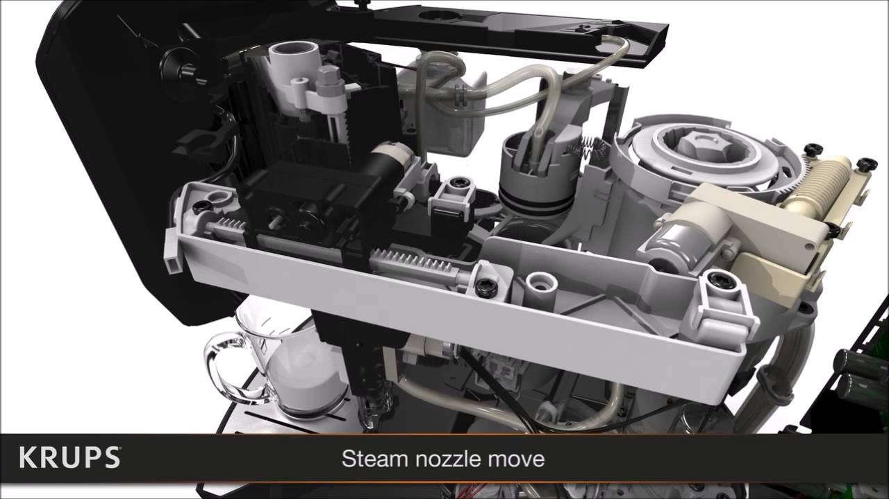
Abstraction - example
imagine: youTube

Slide 6

Abstraction - example
imagine: krupsusa.com

Slide 7
Ways to achieve abstraction in java
There are two ways to achieve abstraction in java
Abstract class (0 to 100%)
Interface (100%)

Slide 8
abstract classes

Slide 9
Abstract classes
A class that is declared as abstract is known as abstract class.It can have abstract methods. It needs to be extended and its method implemented. It cannot be instantiated.
public abstract class Employee {
}

Slide 10
Why do we need abstract class?
Real world example What would you draw when I’d asked you to draw a shape?

Slide 11
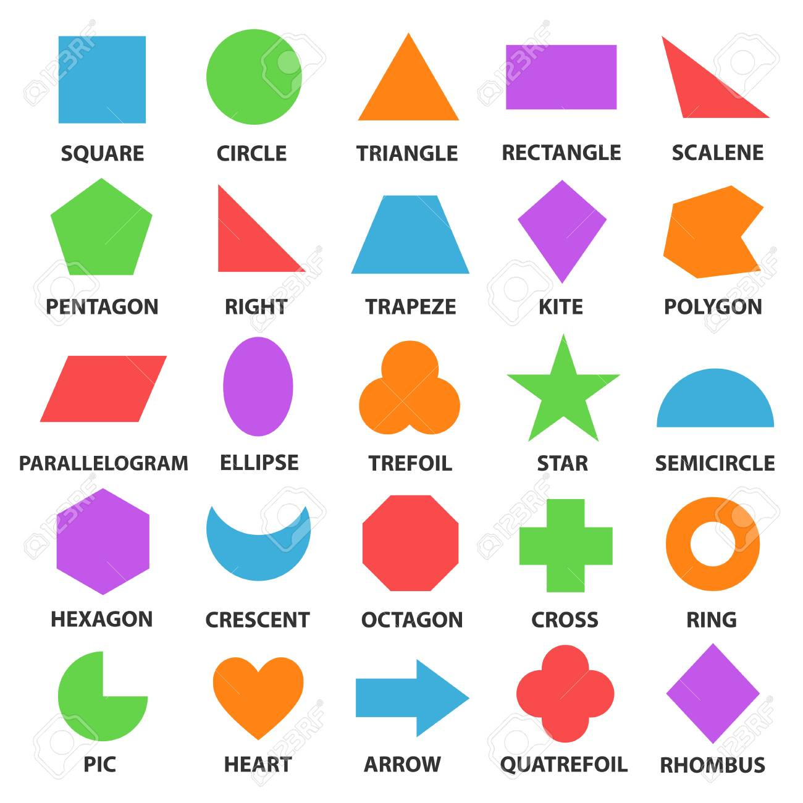
Actual ‘shape’

Slide 12

Abstract method
A method that is declared as abstract and does not have implementation is known as abstract method.

Slide 13
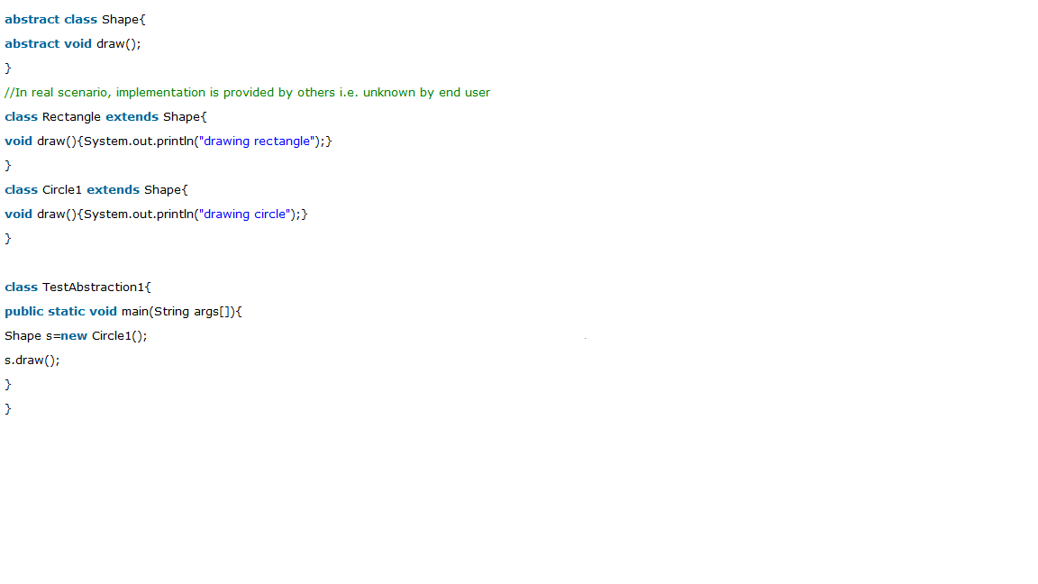
Example of abstract class that has abstract method

Slide 14
Abstract class having constructor, data member, methods etc.
An abstract class can have data member, abstract method, method body, constructor and even main() method.

Slide 15
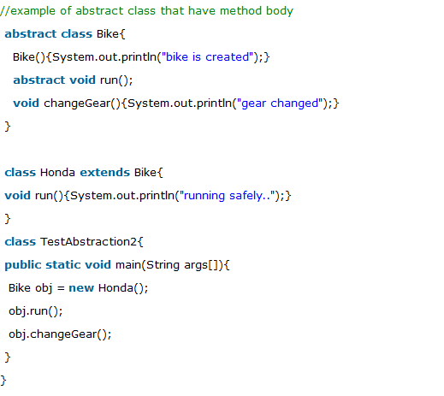
Exampple of abstract class having constructor, data member, methods etc.

Slide 16
Rules
If there is any abstract method in a class, that class must be abstract
2. If you are extending any abstract class that have abstract method, you must either provide the implementation or make this class abstract

Slide 17
interfaces

Slide 18
Interfaces
An interface in java is a blueprint of a class. It has static constants and abstract methods.
The interface in java is a mechanism to achieve abstraction. There can be only abstract methods in the java interface not method body. It is used to achieve abstraction and multiple inheritance in Java.
In other words, you can say that interfaces can have methods and properties (static and final) but the methods declared in interface contain only method signature, not body.
Java Interface also represents IS-A relationship.
It cannot be instantiated just like abstract class.

Slide 19
Why use java interface?
There are mainly three reasons to use interface. They are given below.
It is used to achieve abstraction.
By interface, we can support the functionality of multiple inheritance.
It can be used to achieve loose coupling.

Slide 20
How to declare an interface?
Interface is declared by using interface keyword. It provides total abstraction; means all the methods in interface are declared with empty body and are public and all fields are public, static and final by default. A class that implement interface must implement all the methods declared in the interface.

Slide 21
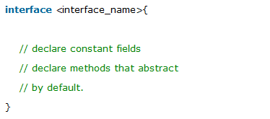
Interface syntax

Slide 22
Java 8 Interface Improvement
Since Java 8, interface can have default and static methods which is discussed later.

Slide 23
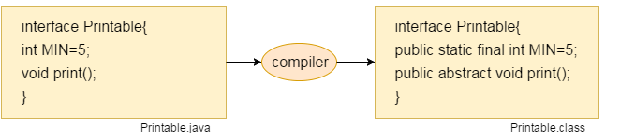
Internal addition by compiler

Slide 24
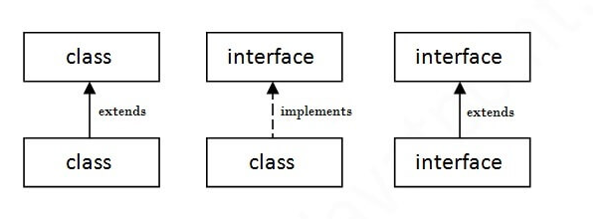
Understanding relationship between classes and interfaces

Slide 25
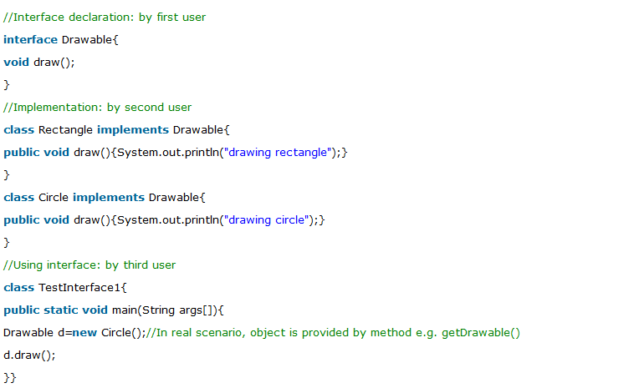
Interface example

Slide 26
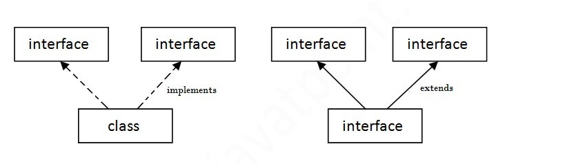
“Multiple inheritance” in java by interface

Slide 27
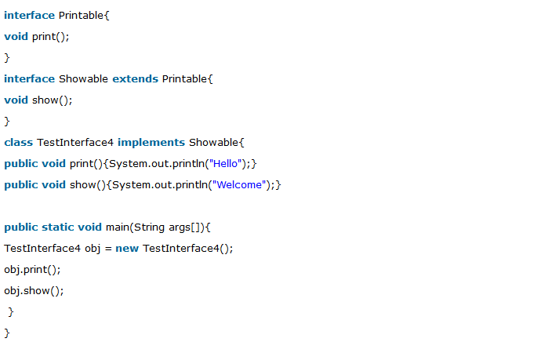
Interface inheritance

Slide 28

What is marker or tagged interface?
An interface which has no member is known as marker or tagged interface. For example: Serializable, Cloneable, Remote etc. They are used to provide some essential information to the JVM so that JVM may perform some useful operation.

Slide 29
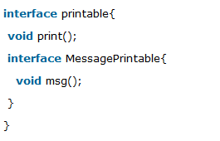
Nested Interface in Java (more about it on nested classes)
An interface can have another interface i.e. known as nested interface. We will learn it in detail in the nested classes chapter. For example:

Slide 30
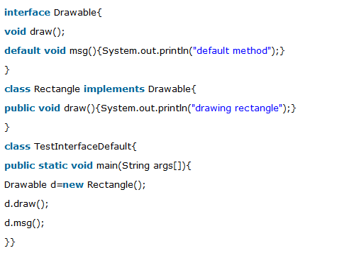
Java 8 default method in interface

Slide 31
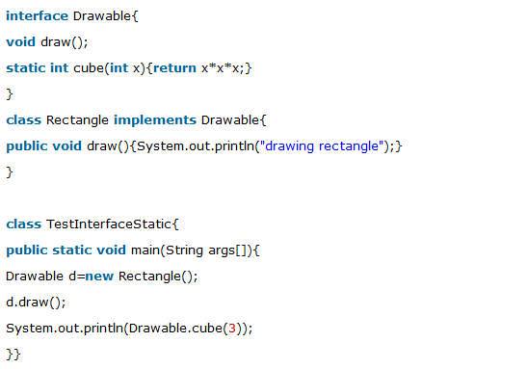
Java 8 static methods in interface

Slide 32
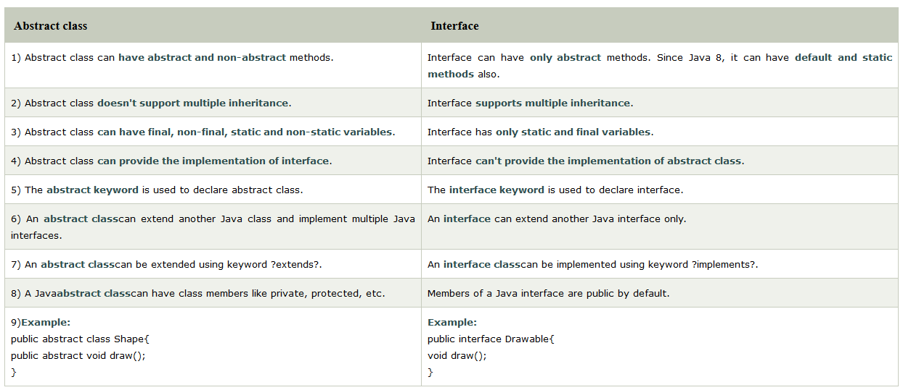
Difference between abstract class and interface

Slide 33
QUIZ

Slide 34
Given the following code snippet, would be the output of the following code?
package schedule;
public class PrintWeek {
public static final void main(String[] days) {
System.out.print(5 + 6 + "7" + 8 + 9);
}
}
A. 56789
B. 11789
C. 11717
D. The code does not compile.
Notes:
B. Remember that Java evaluates + from left to right. The first two values are both numbers,
so the + is evaluated as numeric addition, resulting in a reduction to 11 + "7" + 8
+ 9. The next two terms, 11 + "7", are handled as string concatenation since one of the
terms is a String. This allows us to reduce the expression to "117" + 8 + 9. Likewise, the
final two terms are each evaluated one at a time with the String on the left. Therefore, the
final value is 11789, making Option B the correct answer.

Slide 35
Fill in the blanks:
Given two non-null String objects with reference names apples and
oranges, if apples ______ oranges evaluates to true, then apples ______
oranges must also evaluate to true.
A. ==, equals()
B. !=, equals()
C. equals(), ==
D. equals(), =!
Notes:
A. For this question, remember that if two String objects evaluate to true using ==, then
they are the same object. If they are the same String object, equals() will trivially return
true. Option A correctly reflects this principle. Option B is incorrect as two String
objects that are not the same may still be equivalent in terms of equals(). For example,
apples == new String(apples) evaluates to false, but equals() will evaluate to true
on these String objects. Likewise, Options C and D are also incorrect because two String
objects that are equivalent in terms of equals() may be different objects.

Slide 36
Which of the following are primitives?
int[] lowercase = new int[0];
Integer[] uppercase = new Integer[0];
A. Only lowercase
B. Only uppercase
C. Bother lowercase and uppercase
D. Neither lowercase nor uppercase
Notes:
D. Trick question! While int is a primitive, all arrays are objects. One way to tell is that an array has a public instance variable called length. Another way is that you can assign it a variable of type Object. Therefore, Option D is correct.

Slide 37
How many of the following are legal declarations?
[]double lion;
double[] tiger;
double bear[];
A. None
B. One
C. Two
D. Three
Notes:
C. The array braces are allowed to appear before or after the variable name, making the
tiger and bear declarations correct. The braces are not allowed to appear before the type
making the lion declaration incorrect. Therefore, Option C is correct.

Slide 38
Which of the following create an empty two-dimensional array with dimensions 2×2?
A. int[][] blue = new int[2, 2];
B. int[][] blue = new int[2], [2];
C. int[][] blue = new int[2][2];
D. int[][] blue = new int[2 x 2];
Notes:
C. A two-dimensional array is declared by listing both sizes in separate pairs of braces.
Option C correctly shows this syntax.

Slide 39
How many of the following are legal declarations?
float[] lion = new float[];
float[] tiger = new float[1];
float[] bear = new[] float;
float[] ohMy = new[1] float;
A. None
B. One
C. Two
D. Three
Notes:
B. Since no elements are being provided when creating the arrays, a size is required. Therefore,
lion and bear are incorrect. The braces containing the size are required to be after
the type, making ohMy incorrect. The only one that is correct is tiger, making the correct
answer Option B.

Slide 40
How many of the following are legal declarations?
float[] lion = new float[];
float[] tiger = new float[1];
float[] bear = new[] float;
float[] ohMy = new[1] float;
A. None
B. One
C. Two
D. Three
Notes:
B. Since no elements are being provided when creating the arrays, a size is required. Therefore,
lion and bear are incorrect. The braces containing the size are required to be after
the type, making ohMy incorrect. The only one that is correct is tiger, making the correct
answer Option B.

Slide 41
Quiz: Which of the following does not compile?
A. int num = 999;
B. int num = 9_9_9;
C. int num = _9_99;
D. float f = 15_155;
Notes:
C. Underscores are allowed between any two digits in a numeric literal. Underscores are not allowed at the beginning or end of the literal, making Option C the correct answer.

Slide 42
Quiz: Which is the first line to trigger a compiler error?
A. double d1 = 5f; // p1
B. double d2 = 5.0; // p2
C. float f1 = 5f; // p3
D. float f2 = 5.0; // p4
Notes:
D. Java uses the suffix f to indicate a number is a float. Java automatically widens a type, allowing a float to be assigned to either a float or a double. This makes both lines p1 and p3 compile. Line p2 does compile without a suffix. Line p4 does not compile without a suffix and therefore is the answer

Slide 43
What is the value of (5 + (!2 + 8) * 3 - 3 % 2)/2 in Java?
A. 2
B. 11
C. 16
D. None of the above
Notes:
D. The question looks a lot more difficult than it is. In fact, to solve it you don’t have to compute anything! You just have to notice that the logical complement operator (!), which can only be applied to boolean values, is being applied to a numeric value. Therefore, the answer is that the expression wouldn’t compile or run, making Option D the correct answer.

Slide 44
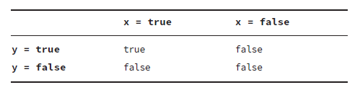
Given the following truth table, which operator for the boolean expressions x and y corresponds to this relationship?
A. --
B. ++
C. ||
D. &&
Notes:
D. The question is about boolean operators. Since Options A and B are numeric operators, they can be instantly disregarded.
The question then simplifies to which boolean expression, && or ||, corresponds to the truth table that only evaluates to true if both operands are true. Only the conjunctive logical && operator represents this relationship, making
Option D the correct answer.

Slide 45
What is the output of the following code snippet?
int hops = 0;
int jumps = 0;
jumps = hops++;
if(jumps)
System.out.print("Jump!");
else
System.out.print("Hop!");
A. Jump!
B. Hop!
C. The code does not compile.
D. The code compiles but throws an exception at runtime.
Notes:
C. The value of jumps and hops is unimportant because this code does not compile, making
Option C the correct answer. Unlike some other programming languages, Java does not
automatically convert integers to boolean values for use in if-then statements. The statement
if(jumps) evaluates to if(0), and since 0 is not a boolean value, the code does not
compile. Note that the value of the jumps variable is irrelevant in this example; no integer
evaluates to a boolean value in Java.

Slide 46
Given the following code snippet, assuming dayOfWeek is an int, what variable type of saturday is not permitted?
final ________ saturday = 6;
switch(dayOfWeek) {
default:
System.out.print("Another Weekday");
break;
case saturday:
System.out.print("Weekend!");
}
A. byte
B. long
C. int
D. None of the above
Notes:
B. Any value that can be implicitly promoted to int will work for the case statement with
an int input. Since switch statements do not support long values, and long cannot be
converted to int without a possible loss of data, Option B is the correct answer.

Slide 47
Întrebări, sugestii, propuneri

